Slide 1
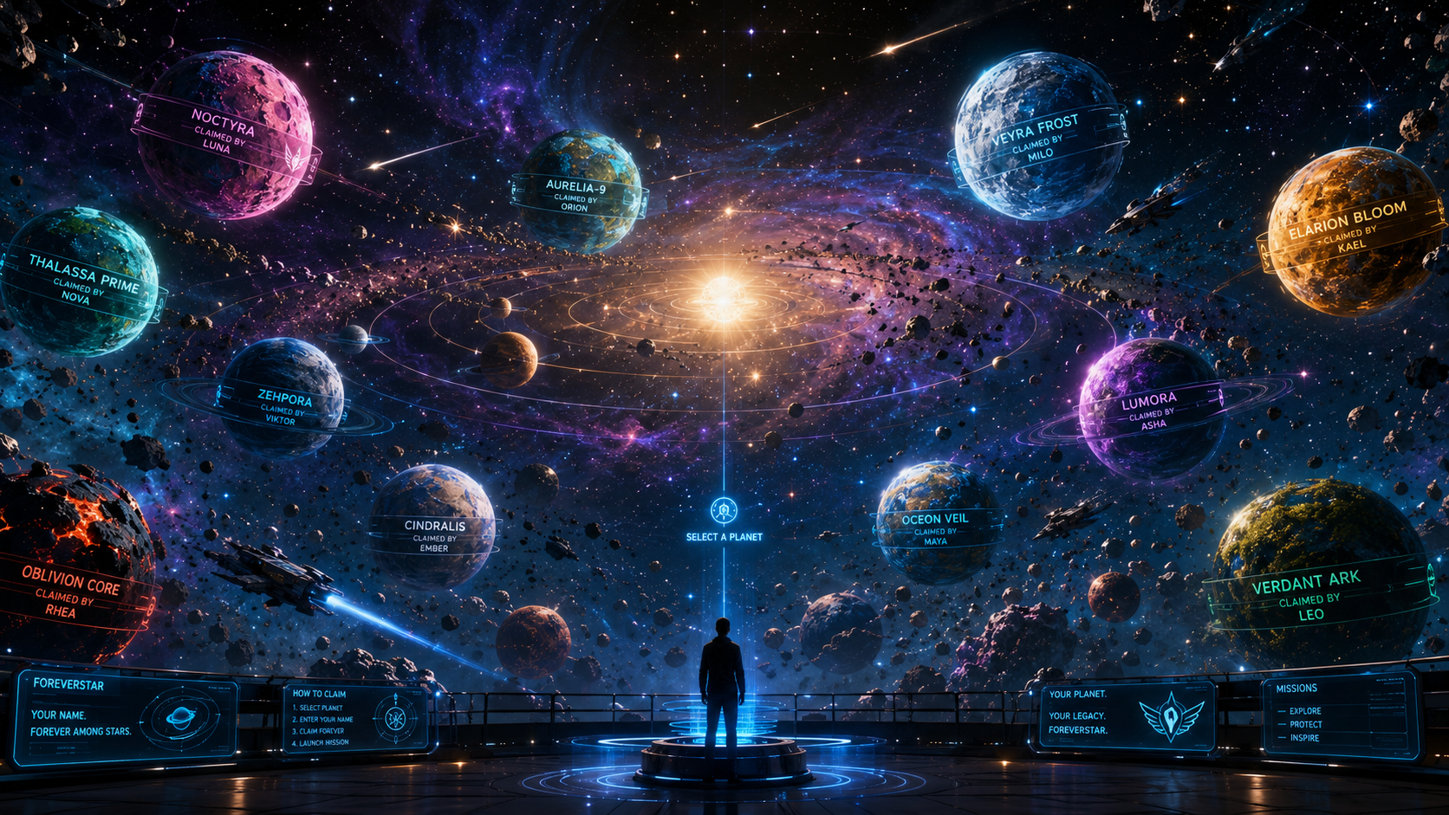
Procedural Universe Generation
• 20 unique procedural planet archetypes
• Biome-driven colors matching collectible cards
• Procedural weather, oceans, lava, ice, crystal worlds
• Asteroids, comets, AI ships and orbital mechanics
• Seed → Biome → Terrain → Weather → Universe
ForeverStar Technical Highlights
✓ Procedural generation
✓ Immersive 360° experience
✓ Real-time cloud sync
✓ Interactive planet ownership
✓ Scalable Unreal Engine architecture

Slide 2
Planet Claim Experience
• Scan QR code
• Phone calibration
• Select planet
• Enter name
• Forever vs One Visit
• Live synchronization
• Name orbits the claimed planet
ForeverStar Technical Highlights
✓ Procedural generation
✓ Immersive 360° experience
✓ Real-time cloud sync
✓ Interactive planet ownership
✓ Scalable Unreal Engine architecture

Slide 3
Cloud Infrastructure
• Cloud-hosted backend
• Unique QR generation
• Location-aware procedural seeds
• Planet ownership database
• API gateway to Unreal Engine
• Persistent universe across visits
ForeverStar Technical Highlights
✓ Procedural generation
✓ Immersive 360° experience
✓ Real-time cloud sync
✓ Interactive planet ownership
✓ Scalable Unreal Engine architecture

Slide 4
Unreal Engine Blueprint Systems
• Planet Manager
• Spawn Manager
• Orbit Controller
• Selection System
• Weather Generator
• Ownership Manager
• Mission & Save Systems
• Niagara FX + Lumen + optimization
ForeverStar Technical Highlights
✓ Procedural generation
✓ Immersive 360° experience
✓ Real-time cloud sync
✓ Interactive planet ownership
✓ Scalable Unreal Engine architecture

